Slide 1

How has speech in
changed over time?

Slide 2
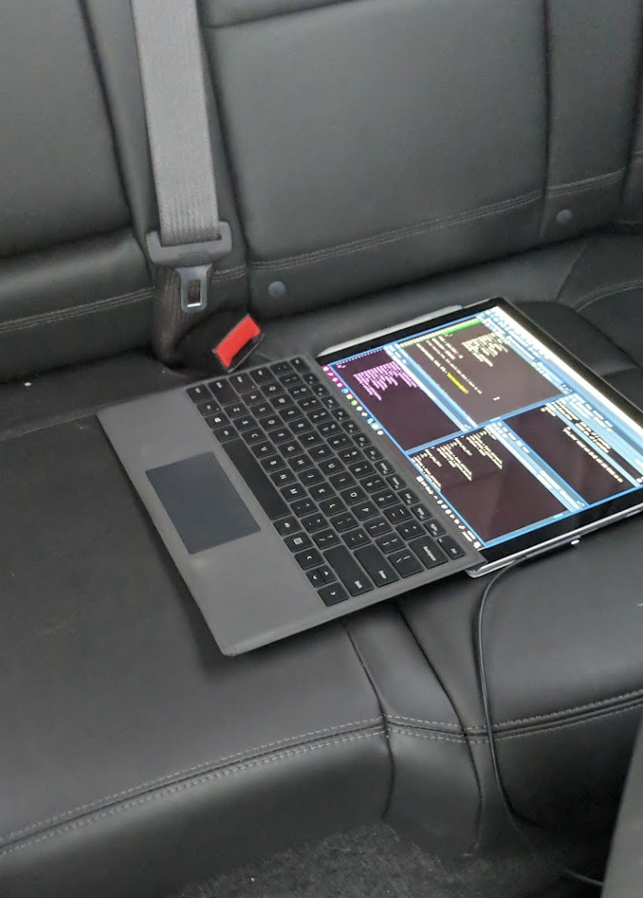
Scraped Show Transcripts
Campaign 1 Episode 1 through Campaign 3 Episode 11
266 Episodes - (removed one episode that was a tutorial of D&D)
Episodes range from 3.5 hours to 6 hours
697,243 lines of data!!!
Performed sentiment analysis to see positivity, emotions, and profanity
Over 5 hours of processing time!!!

Slide 3
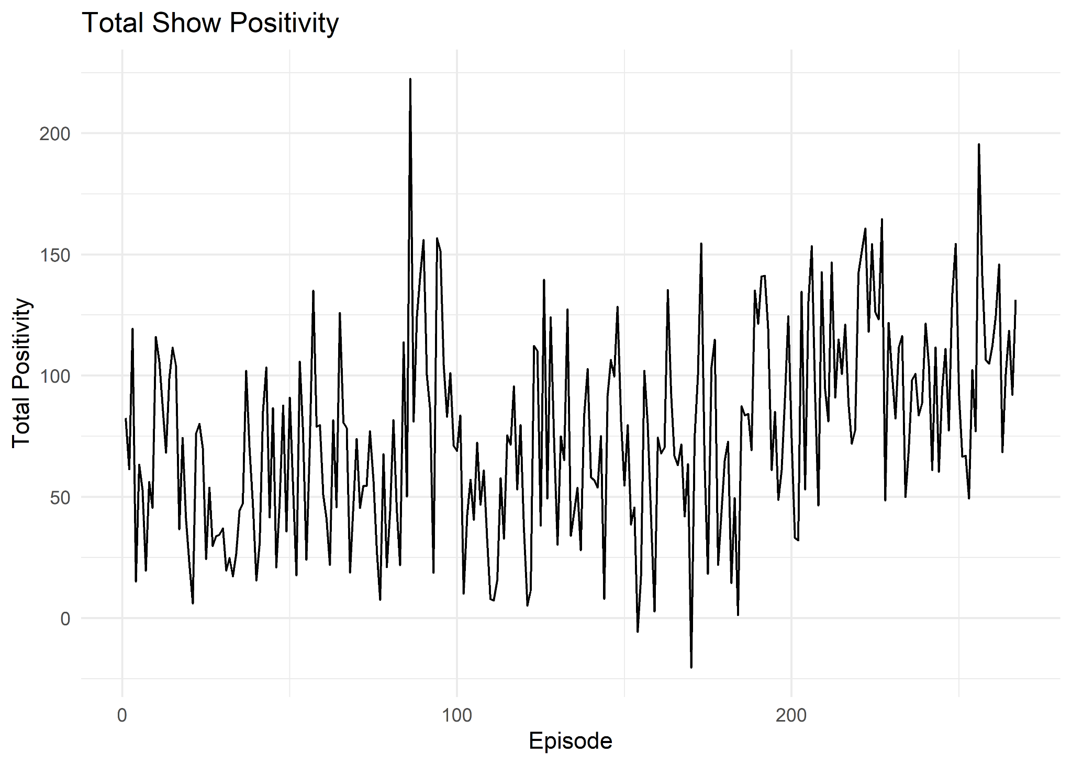
Good Vibes from Here On Out

Slide 4
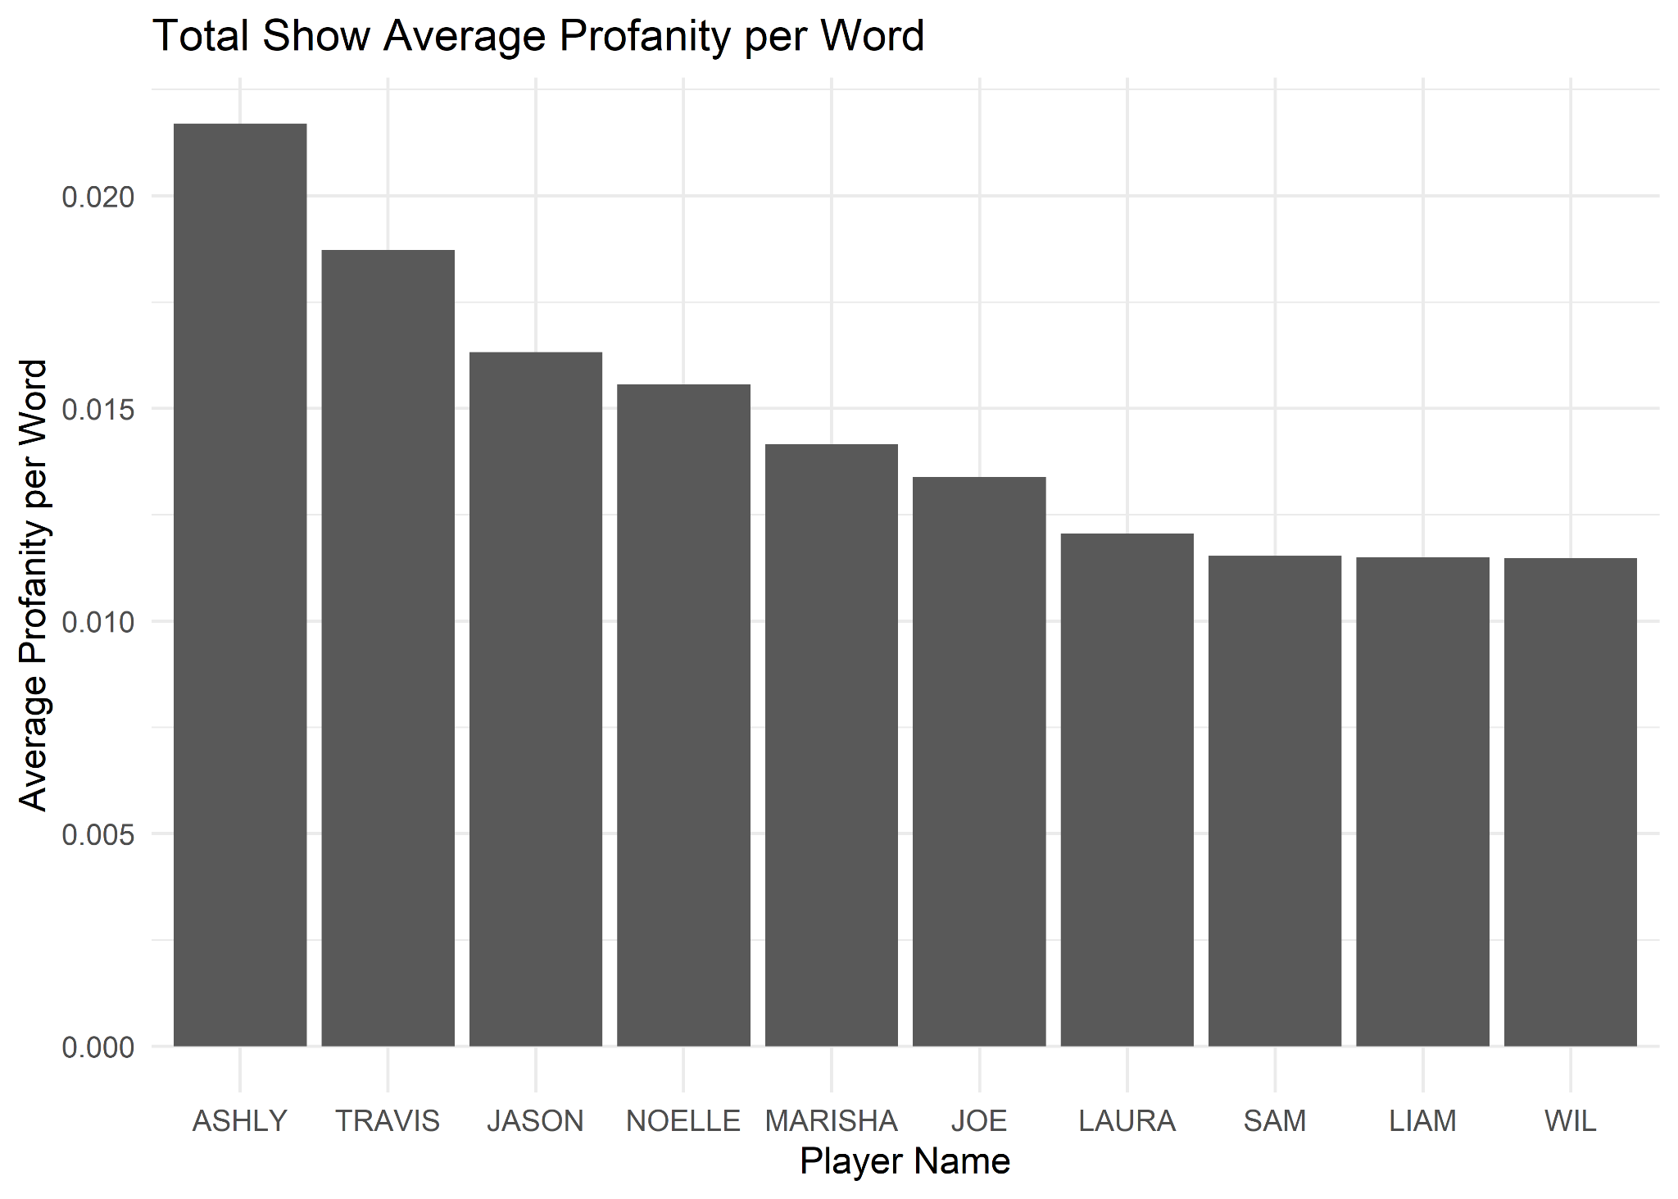
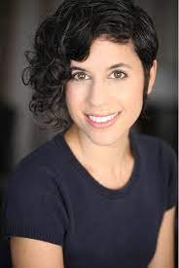

Ashly Burch - Sultan of Swearing

Slide 5
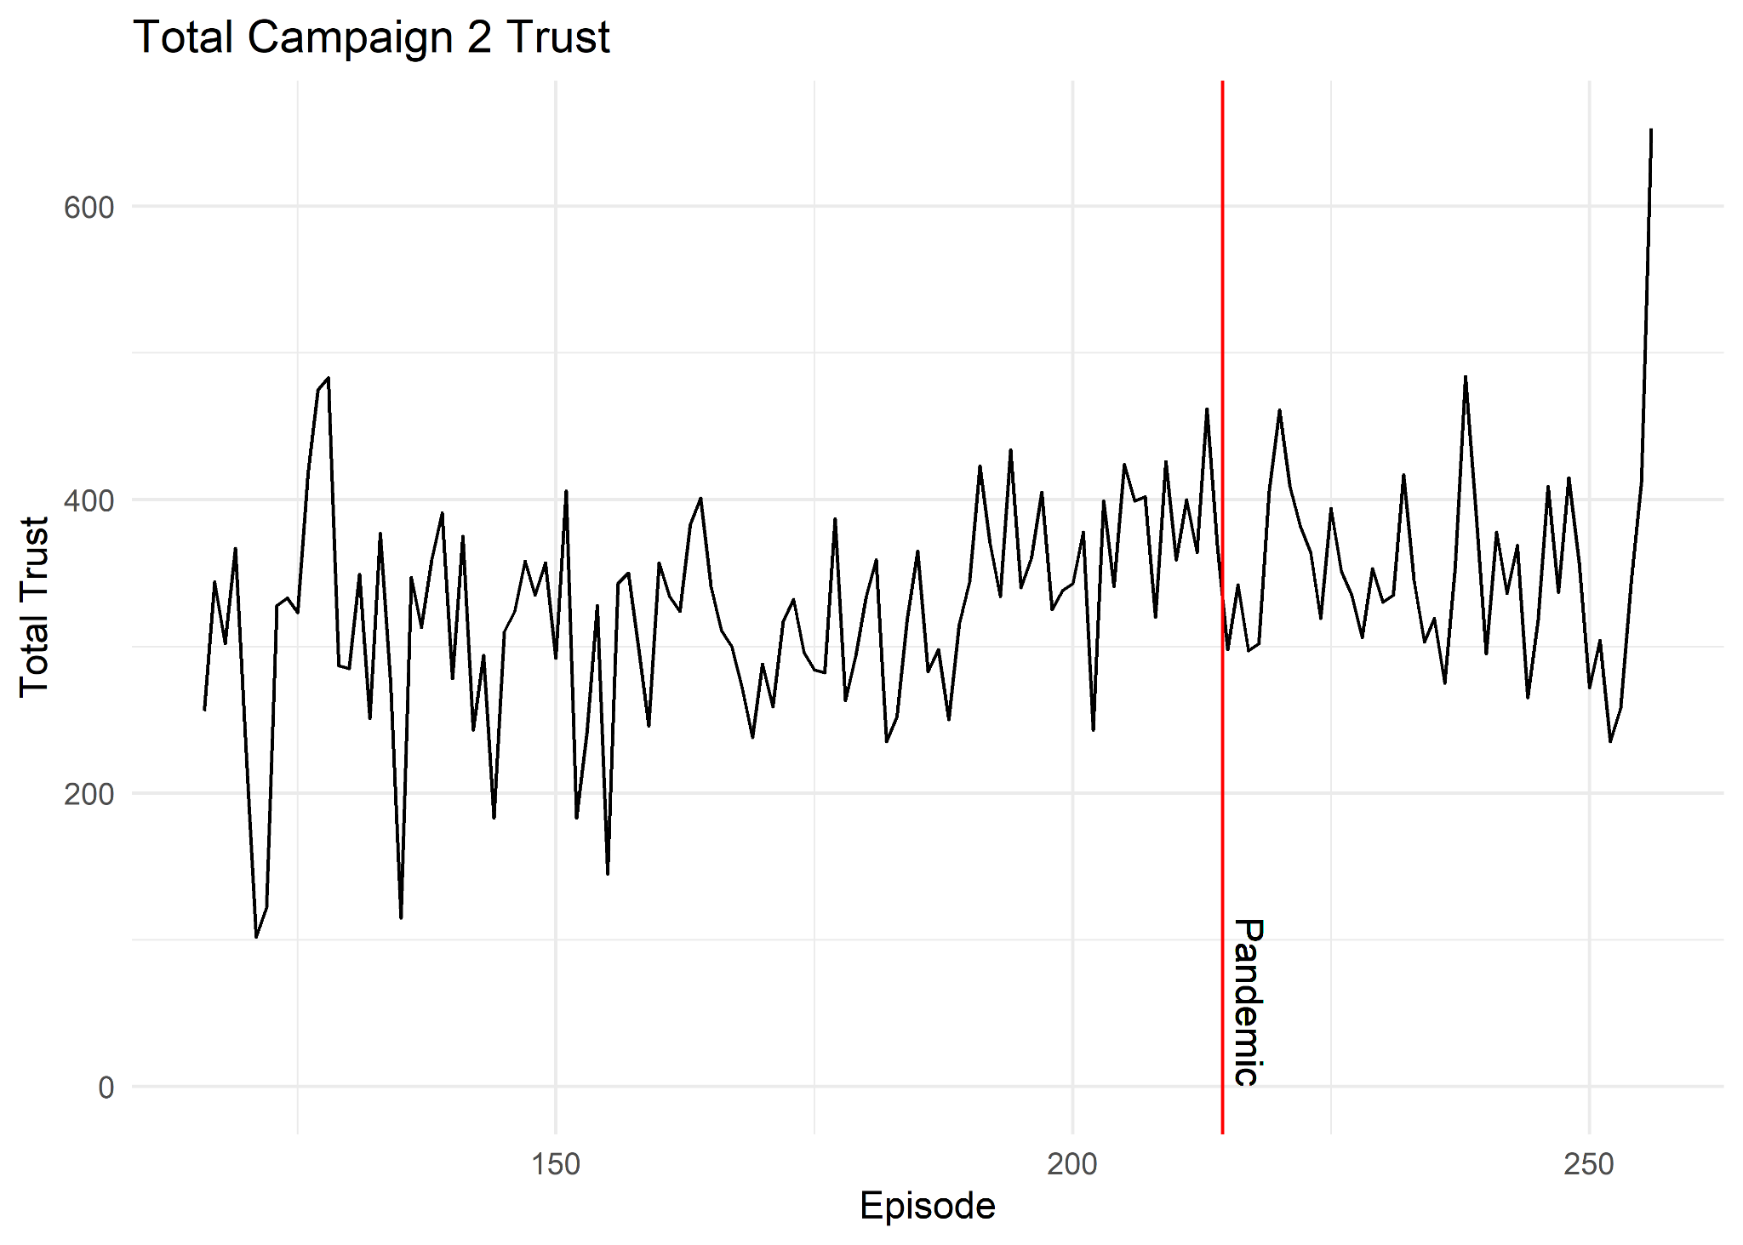
Emotions Suppressed Post-Pandemic

Slide 6
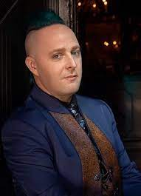
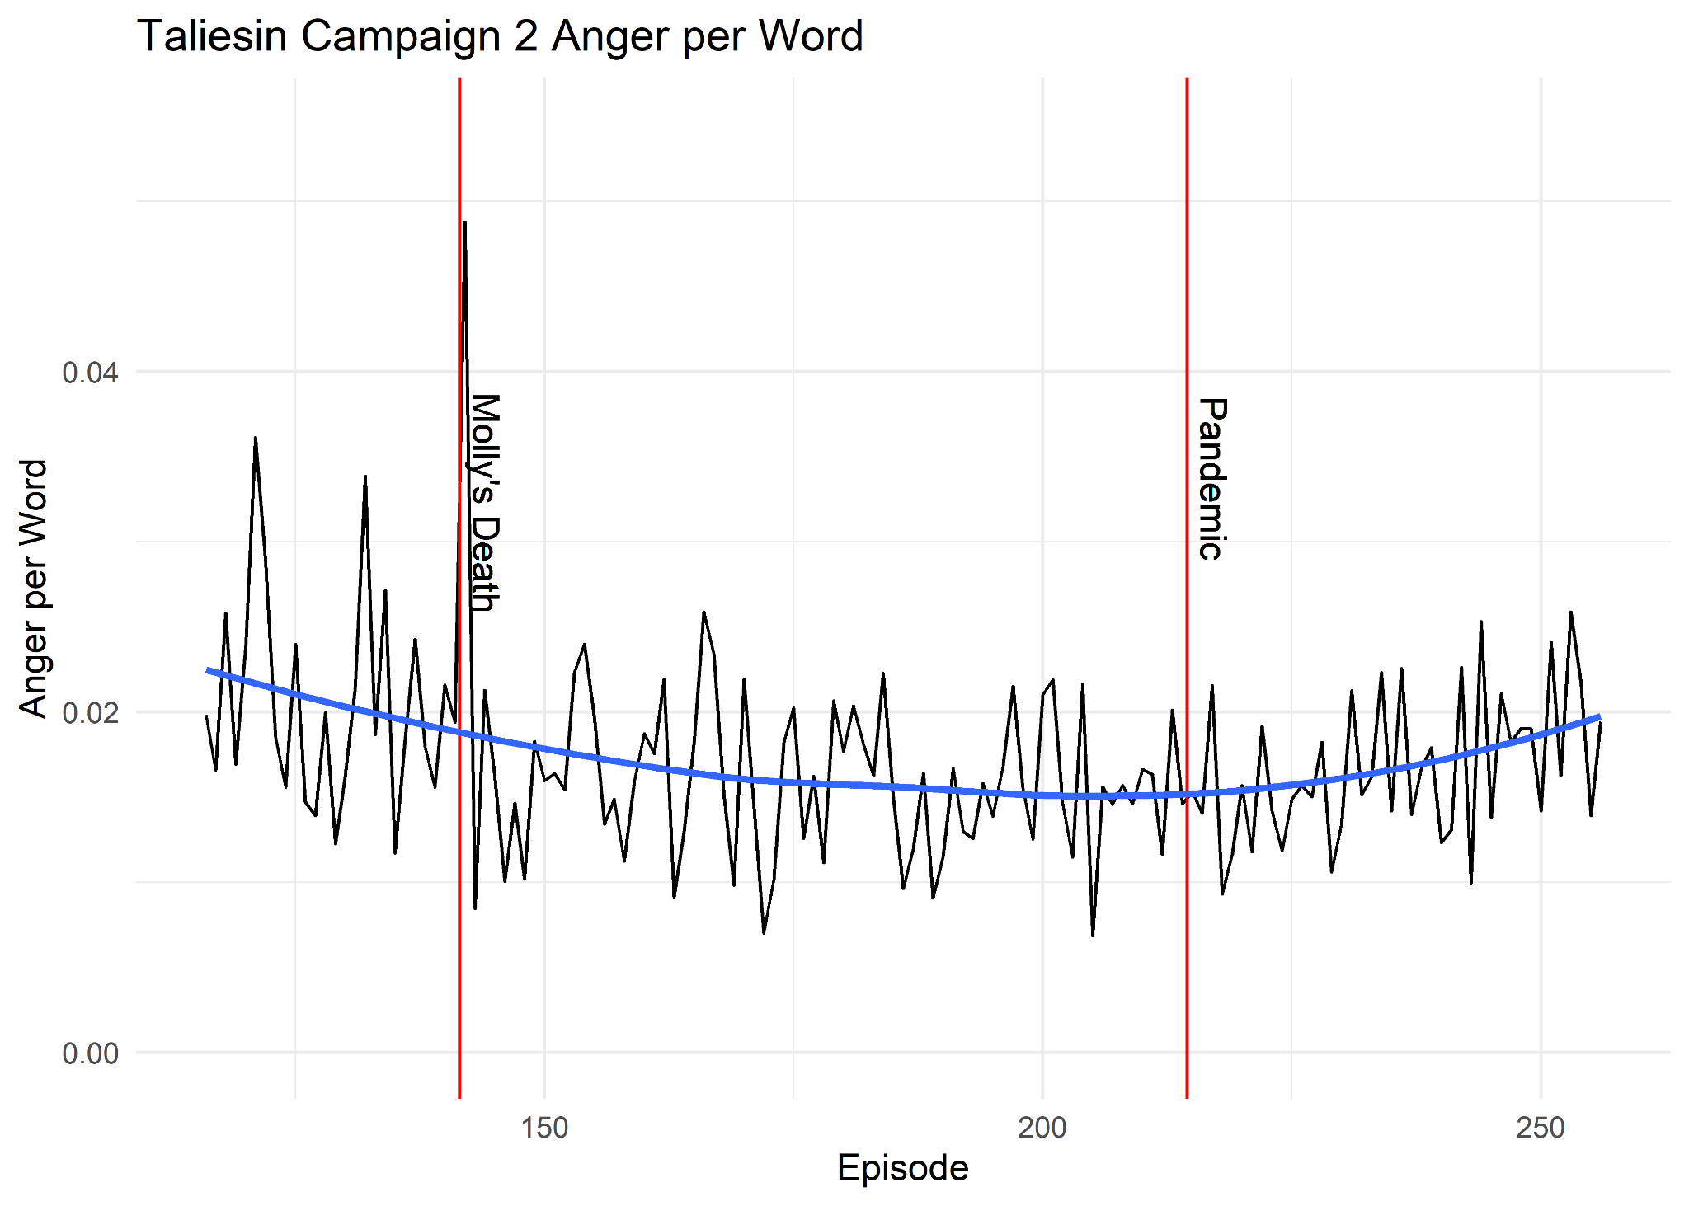
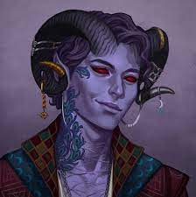
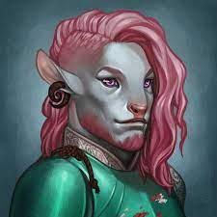
Character Matters

Slide 7
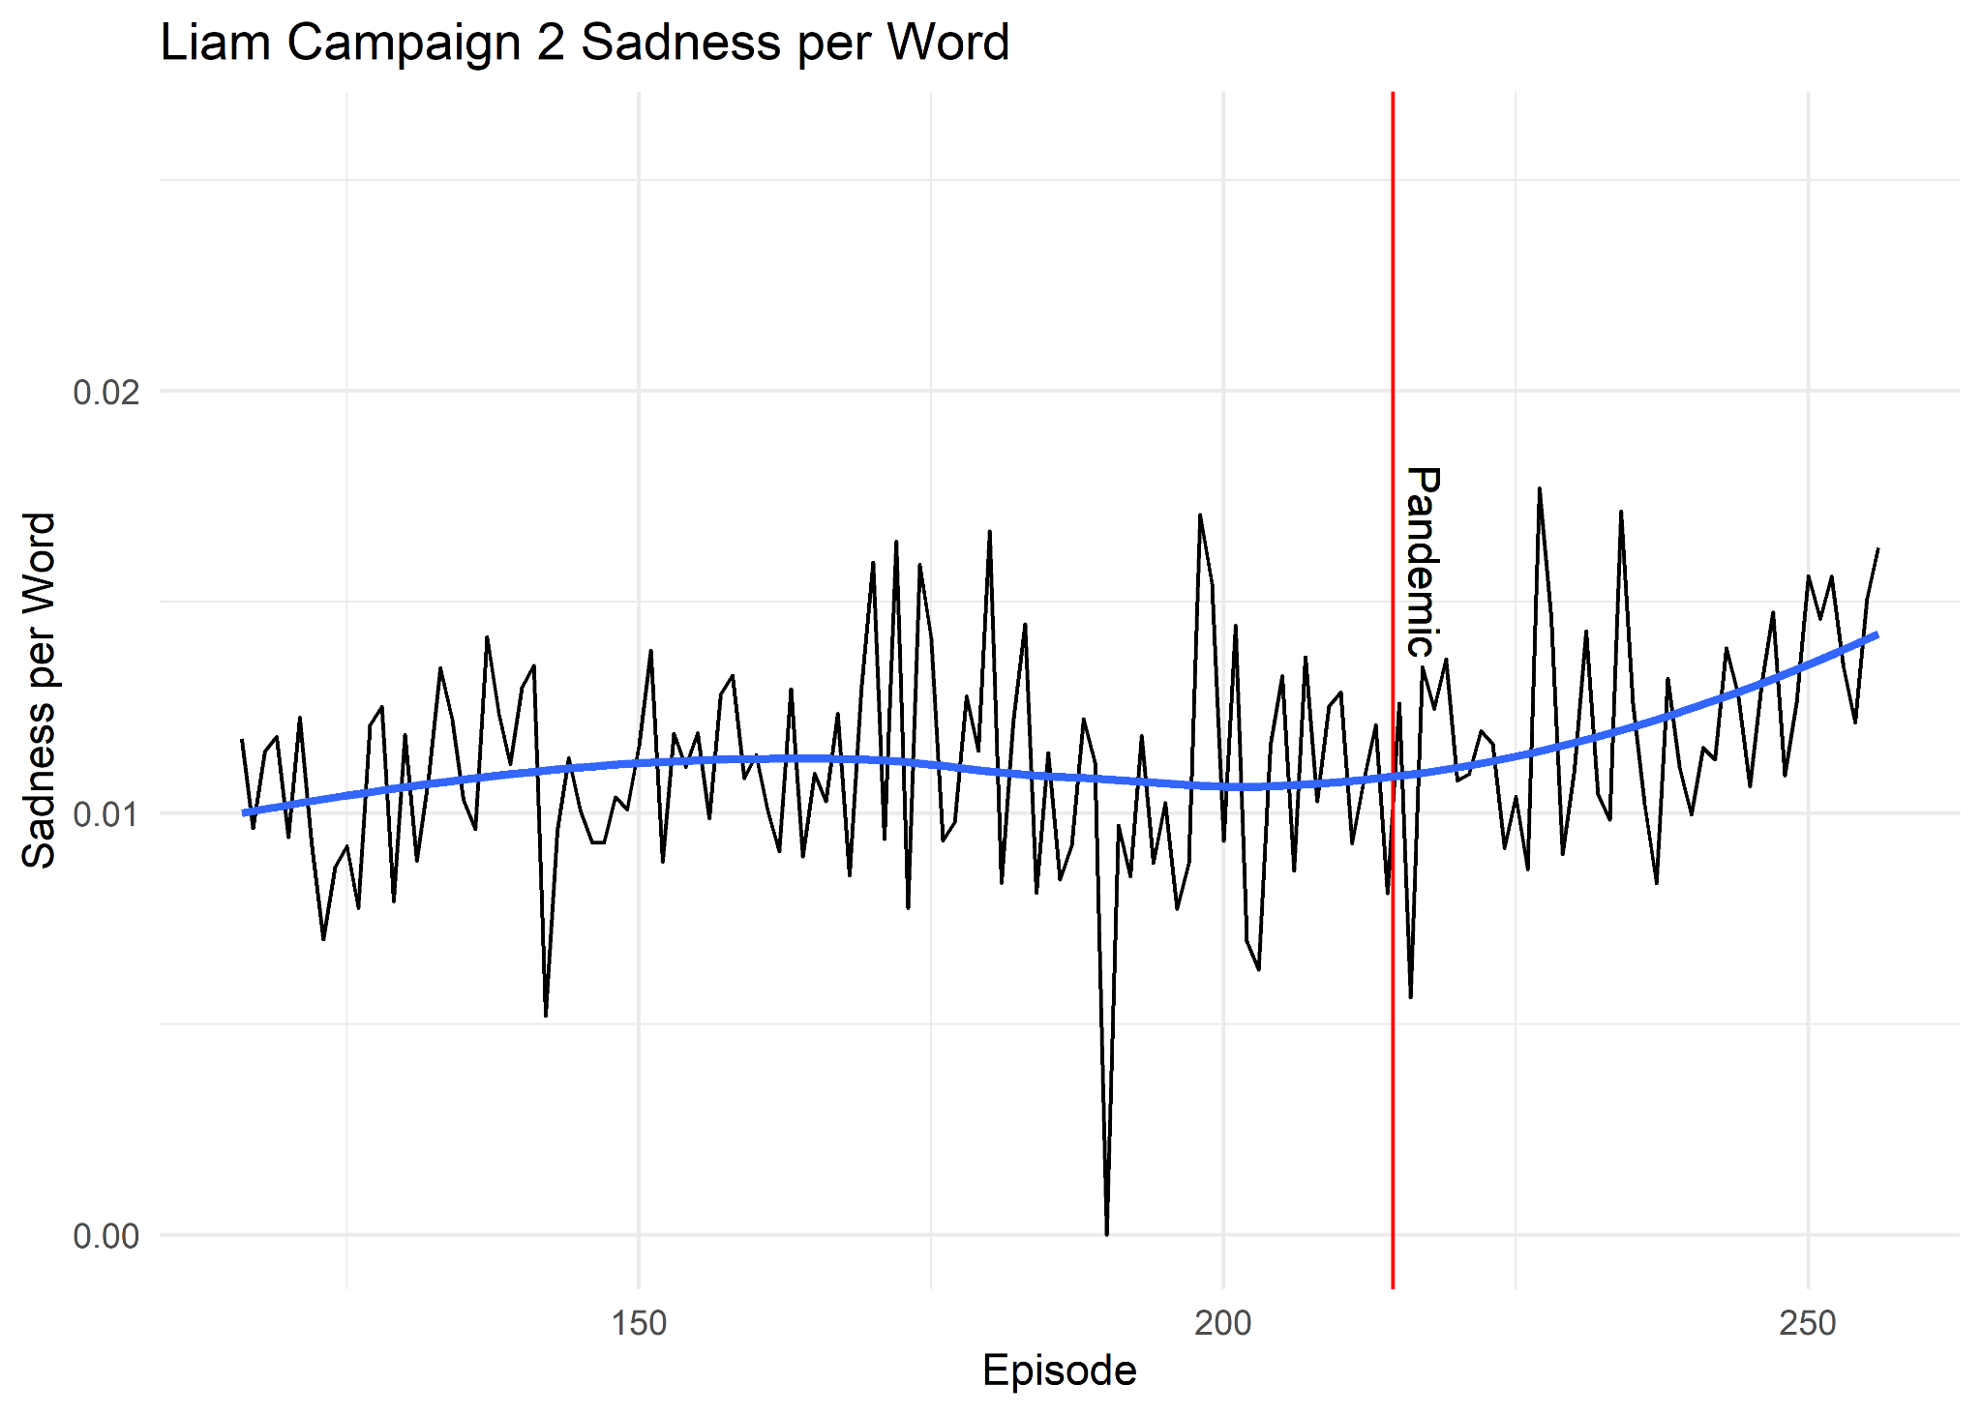
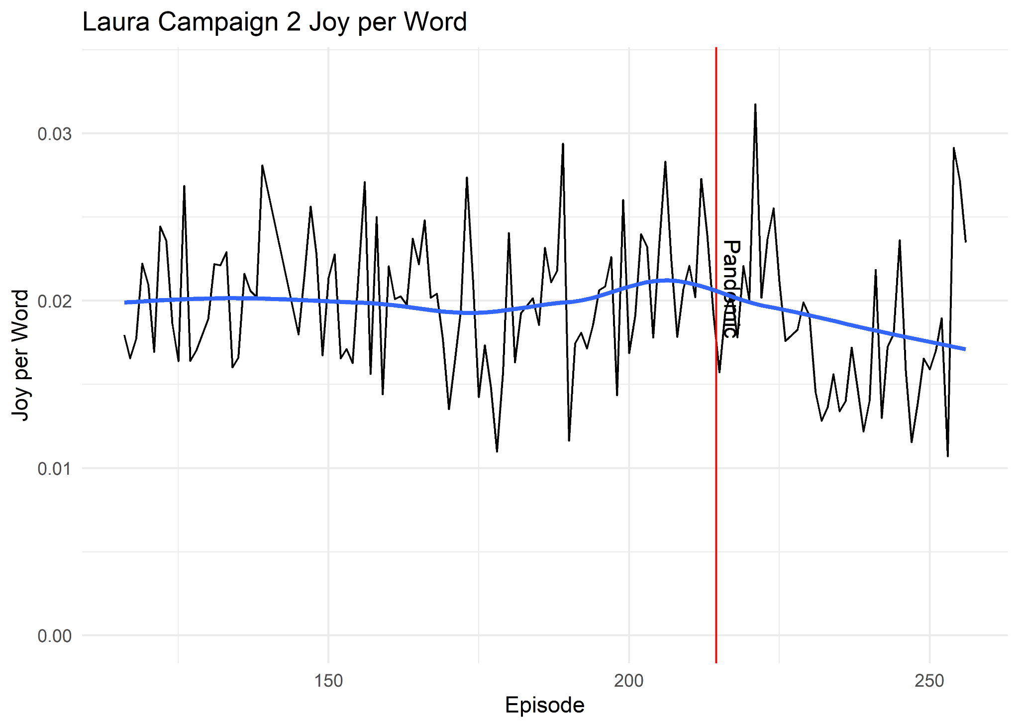
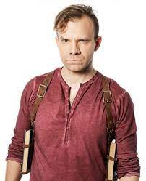

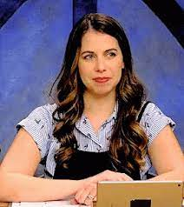
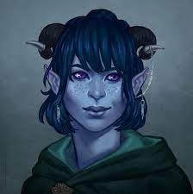
Pandemic or Story Climax?

